Slide 1
Brothers or Friends?: Taiwanese Voters’ Perception about the Relationship between the Two Sides of the Taiwan Strait
是兄弟？是朋友？臺灣選民對兩岸關係的想像
Frank Cheng-shan Liu 劉正山
Associate Professor
Institute of Political Science
National Sun Yat-Sen University, Taiwan, ROC
csliu@mail.nsysu.edu.tw
Yitan Li 李一潭
Assistant Professor
Department of Political Science
Seattle University, USA
liy@seattleu.edu

Slide 2
Introduction
Central questions
  How Taiwanese voters imagine the relationship with Mainland China and the extent to which these perceptions influence their attitudes toward cross-strait cooperation
Evolution of Cross-Strait Relations
Methods and Data
Preliminary Findings and Analysis
Conclusion and Discussion

Slide 3
Evolution of Cross-Strait Relations
Economic convergence
Political divergence
  Taiwan’s Democracy
  Generation Politics
The construction of new Taiwanese identity
The Taiwan issue
  Territoriality/Antiquity
  Identity
Sunflower Movement

Slide 4
What Matters and How Do We Know?
National/ethic identification
Party identification
Country identification
Generation politics
Gender
Education attainment
Data and methods

Slide 5
Findings: Descriptive Analysis
How do you see our relationship with Mainland China, is it more like father and son, brothers, couples, friends, or enemies?
您覺得我們和大陸是什麼關係，是父子、兄弟、夫妻、朋友，還是敵人？
Do you hope that Taiwan and Mainland China become one country?
請問您希不希望臺灣與大陸合為一個國家？

Slide 6
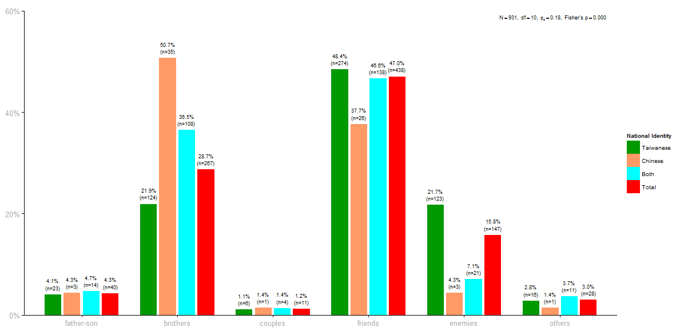
Figure1: The Distribution of Imagined Relationships with Mainland China by National Identity

Slide 7
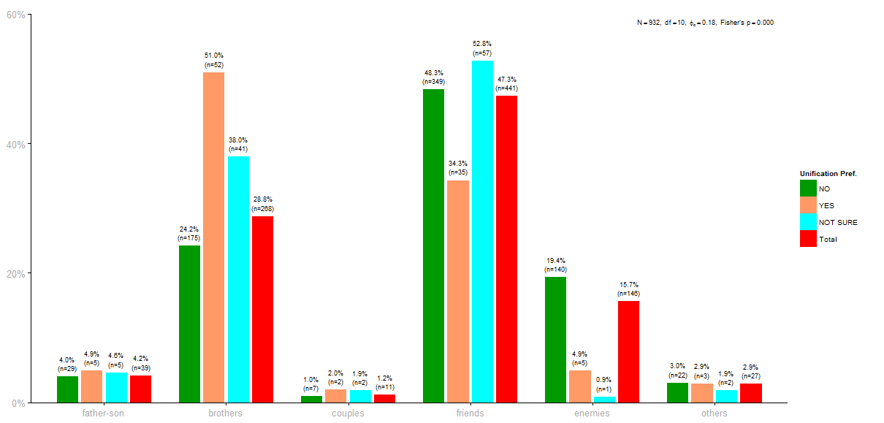
Figure 2: The Distribution of Perceived Relationships with Mainland China by Unification Preferences

Slide 8
Findings: Explanatory Analysis
National/ethnic identification
Party identification
Country identification
Democratic influence
Generational gap
Difference in gender and education attainment

Slide 9
Table 1: Factors of the Imagined Relationships with Mainland China

Slide 10
Table 1: Factors of the Imagined Relationships with Mainland China

Slide 11
Findings: Future Economic Cooperation
Our government has been negotiating with Mainland China regarding economic cooperation, do you prefer stepping forward bravely or watching steps and slowing down?
目前政府正在推動兩岸經貿談判，請問您覺得政府應該更勇敢積極一些，還是小心謹慎一些？
Do you think that our economic power can keep the cross-Strait status quo?
我們的經濟實力是否足以能維持兩岸的現狀？
How much do you hope that Mainland China becomes a democracy?
請問您希不希望大陸成為民主國家？

Slide 12
Table 2: The Imagined Relationships with Mainland China and Attitudes toward Economic Cooperation (1)

Slide 13
Table 3: Economic Cooperation (2)

Slide 14
Table 3: The Imagined Relationships with Mainland China and Attitudes toward Economic Cooperation (2)

Slide 15
Conclusion and Discussion
The findings help explain the dynamics of Sunflower Movement.
brothers vs. friends
Democracy vs. Economy (CSSTA)
Dual national identity and positive attitudes toward economic cooperation
Notes:
It is clear to us that the movement was initiated by individuals who resist unification and hence who are likely to see Mainland China as an enemy. Because the issue is salient and connected directly to Mainland China, the movement was echoed by those who share the same Taiwanese national/ethnic identity, particularly those younger than 45. However, the Sunflower Movement could not attract support from the older generation (those above 45) who likes to see Mainland China as a brother (1st & 2nd generations) and less likely to see Mainland China as an enemy (3rd generation). The movement followers started to feel conflicts between their action and will, because those younger than 45 are the voters that have been looking forward to economic cooperation with Mainland China. The silent objection of the movement by the older generations and the confusion embedded within the mind of the younger generations could lead to the decline of the scale of the movement.

